Slide 1
Year 3 – Lesson 4
Food Nutrition
To understand how food and diets are influenced around the world.
To learn about alternative diets (veganism).

Slide 2
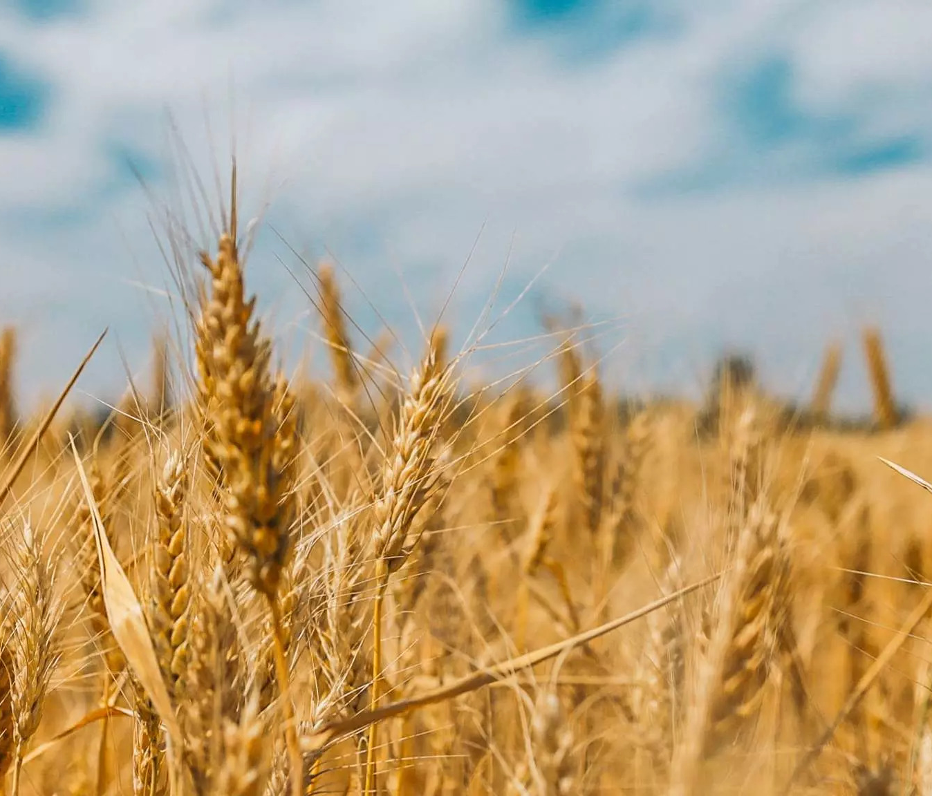
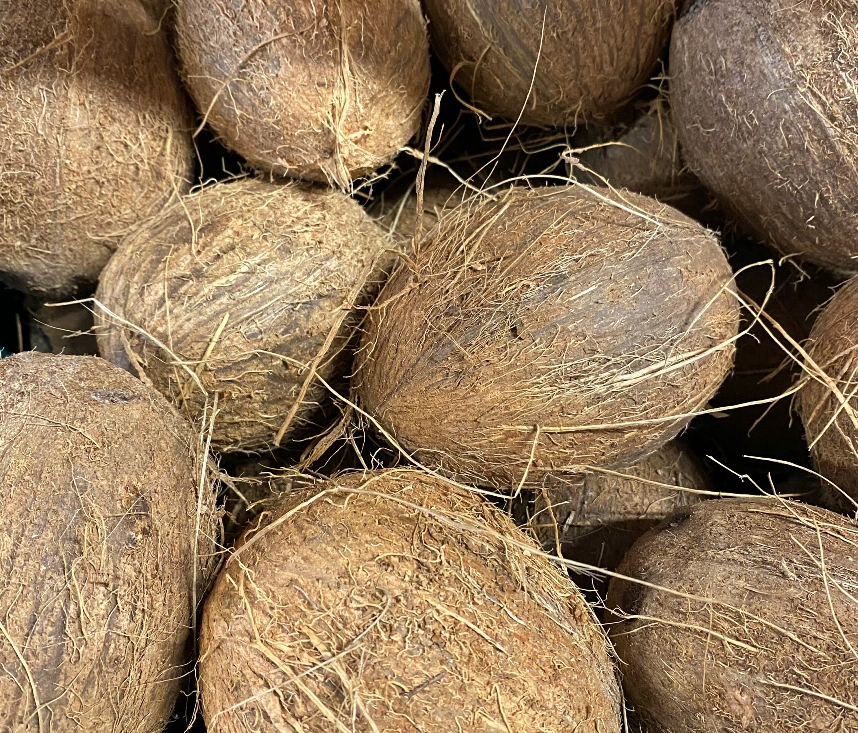
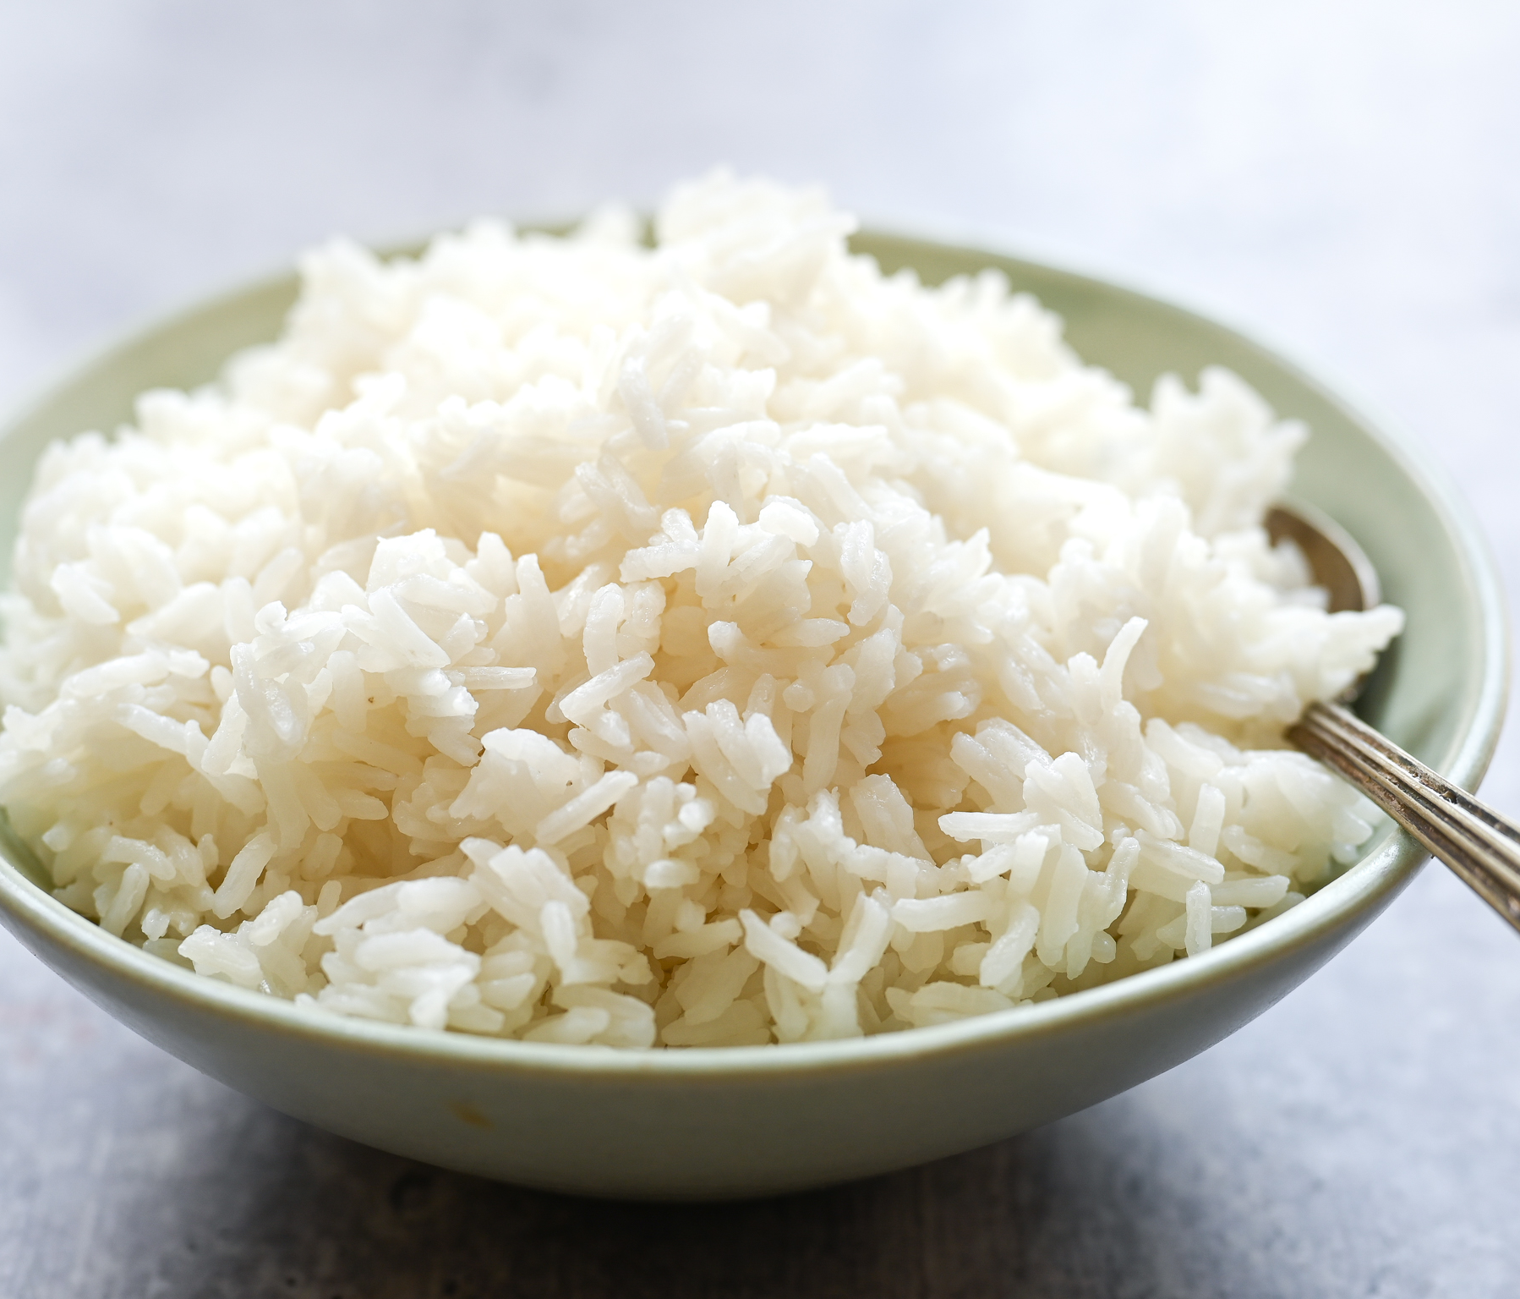
Which of the following foods Can be Grown in the United Kingdom?

Slide 3
Where did the other Foods come From?
Tropical, Balanced Rainfall
Tropical, High Rainfall
Tropical, Balanced Rainfall
Central/South America
Africa
North Australia
South East Asia
Asia (90%)
Central/South America
Africa
North Australia
South East Asia

Slide 4
Movement of Food:
In today’s world, food can easily be transported all over the world due to:
- Refrigeration
- Fast transport methods
- Agreements between countries
However, many years ago, we would not have had access to as many foods from around the world.

Slide 5
How a country’s foods and recipes can change over time:
Every country around the world has foods that it can easily grow or get from neighbouring countries. However, through history, people have travelled around the world from afar. When they have done this, they have taken foods from their own country and introduced them to the new one. Along with recipes and cultural influences of their own.
Many countries now have a variety of foods available from different cultures around the world.
On the next slide, we’ll look at a particular example.

Slide 6
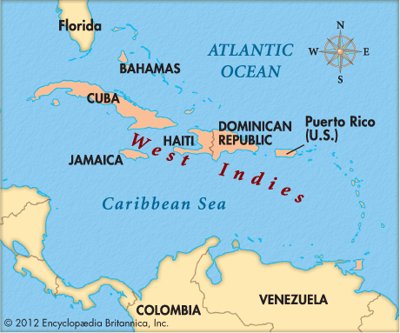
West Indies and the Caribbean
In 1492, Christopher Colombus and his Spanish fleet arrived in the Caribbean looking for a western route to the eastern country of India! They were hoping to be involved in the spice trade of India. He named the found islands and America, the Indies in belief that it was the most eastern part of India. When later discovering it wasn’t, they named their new found Indies, the West Indies and the other (India) was referred to as the East Indies.
Upon arriving, he brought with him: coconuts, chickpeas, aubergines, onions and garlic.
Through the years that followed, other countries travelled to the West Indies and brought a range of foods and spices, such as cumin, into the area.

Slide 7
Classroom Kitchen Online is a service of Innovative Education Ltd.

